Slide 1
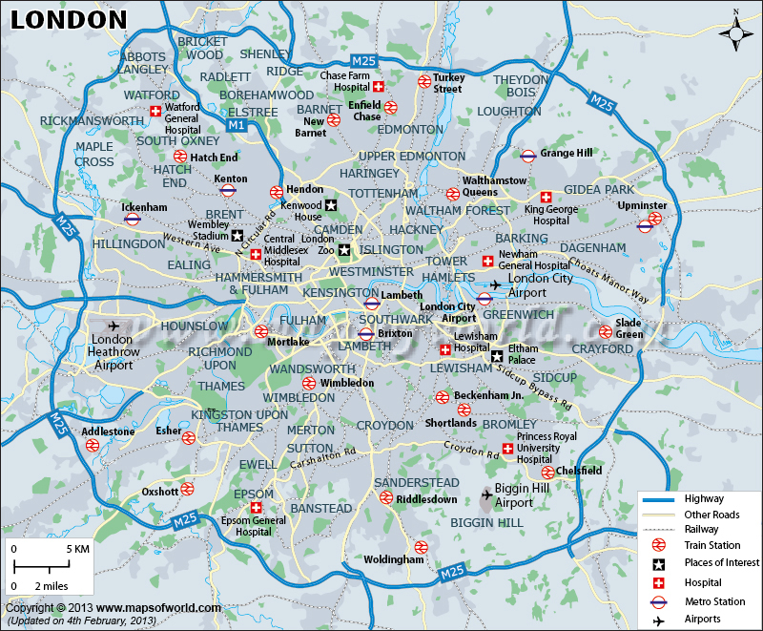
Housing and Population in London Data Science Capstone Project
November 2020
By: Ludwig Forsberg

Slide 2
Introduction
London has seen increasing population due to domestic and international immigration, due to economic opportunities
Housing supply has been lagging and disproportionally built across Greater London
Therefore, are there any boroughs more than others where a focus on house supply should be, with a varied venue scene and close to public transportation?

Slide 3
Data & Data Cleaning
Data required and obtained was:
London Underground station coordinates
LA (Local Authority) coordinates
Housing supply statistics from Greater London by LA
Population statistics of Greater London by LA
Foursquare API venue data for London by LA
The housing and population statistics found was rather intricate in large multi-sheet Excel files, so I consolidated those two with the LA coordinates in a csv in Excel before uploading it

Slide 4
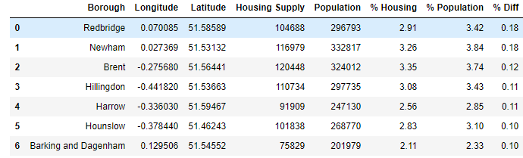
Methodology
Used share of percentage of housing supply and population, and the subsequent difference between them to identify which boroughs had the highest need, i.e. where share of population was higher than share of housing supply
K-Means clustering using 5 clusters was used to identify and compare the type of venues by cluster, including transportation

Slide 5
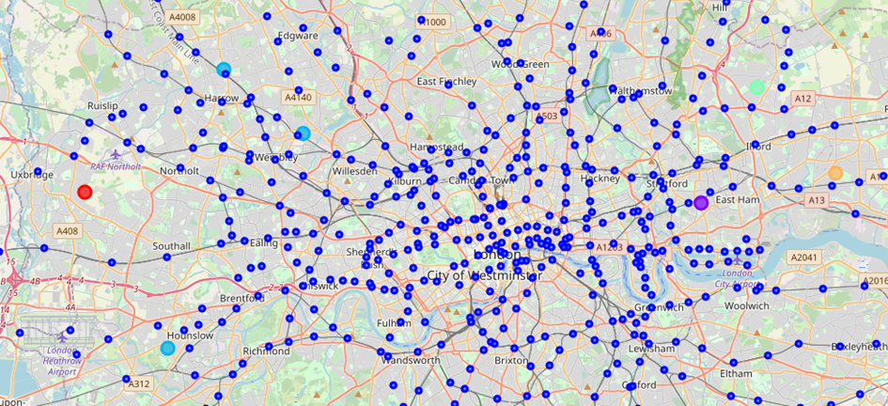
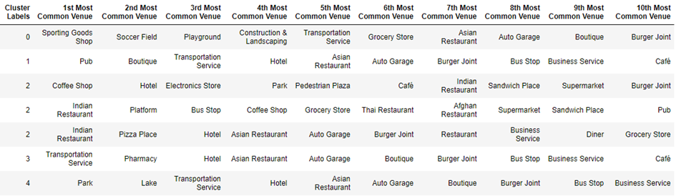
Results
Results showed that based on variety of venues and proximity to public transport, all boroughs apart from Hillingdon (red circle in map) had the greatest opportunity and ROI for an increase in house supply

Slide 6
Conclusions
Further data attributes need to be added to ensure a more detailed recommendation can be given, to ensure the right type of housing is built:
Age
Income
Existing housing and quality thereof
Employment levels

